Slide 1
Focus Question: After defeating the British in the Revolution, what kind of government did American leaders create?
Do Now:
Which is a bigger threat to freedom – monarchy or anarchy?
A nation with one ruler.
A nation with no ruler.

Slide 2
Focus Question: After defeating the British in the Revolution, what kind of government did American leaders create?
Homework:
p. 2, 3 &
Read & Highlight p. 20 & answer questions on p. 21 in packet.

Slide 3
You are a citizen of the new American nation. What kind of national government do you want to create? Begin with the chart below:
 | Would be GOOD for the new nation because… | Would be BAD for the new nation because…
A STRONG Gov’t
A WEAK Gov’t

Slide 4
The Articles of Confederation
The first constitution of the United Stated of America, 1777
(ratified 1781)
To all to whom these Presents shall come, we the undersigned Delegates of the States affixed to our Names send greeting…

Slide 5
The Articles of Confederation - Opening statement
Article I. The site of this confederacy shall be “The United States of America.” Article II. Each state retains its sovereignty [supreme power, authority], freedom and independence, and every power, jurisdiction [authority] and right, which is not by this confederation expressly delegated to the United States, in Congress assembled. Article III. The said states hereby severally enter into a firm league of friendship with each other, for their common defense, the security of their Liberties, and their mutual and general welfare, binding themselves to assist each other, against all force offered to, or attacks made upon them, or any of them, on account of religion, sovereignty, trade, or any other pretense [reason] whatever.

Slide 6
The Articles of Confederation
The Articles of Confederation contained the first plan for how the U.S. government would work.
American leaders feared the kind of strong government they had under the British, therefore, they purposely created a WEAK national government.
The individual states had most of the power; each state even had its own currency.
Under this system, Congress had not power to collect taxes, there was no executive branch or national court system.

Slide 7
The Articles of Confederation
Articles of Confederation = 1st plan / US govt.
Am leaders feared strong govt. /Britain → created weak national govt.
States / most power / diff currencies
Congress ≠ power to tax / no exec branch / no court system

Slide 8
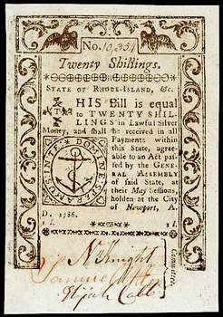
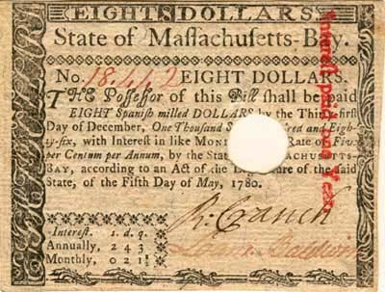
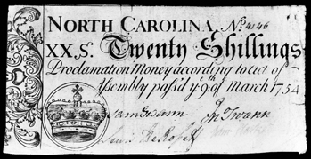

Slide 9
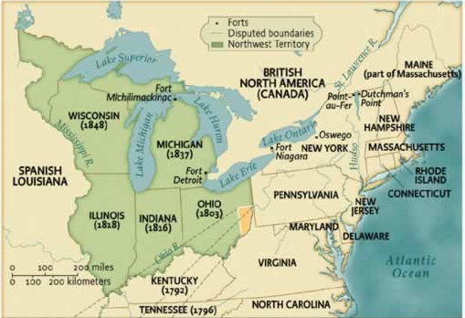
The Northwest Ordinance
Created a way to admit states from the Northwest territory
Guaranteed rights to those living there.
Outlawed slavery in the NW territory.
Best accomplishment of the Confederation Congress, passed in 1787.

Slide 10
Articles of Confederation EXIT TICKET
Directions: Write notes that answer the question words for the kernel. Then, expand the sentence kernel including your notes.
Kernel: They created a weak one.
Who?………………………………………….
What?............................................................
When?.........................................................
Why? ………………………………………….
Expanded Sentence:_______________________________________________________________________________

