Slide 1
Focus Question: What are the main ideals of the Declaration of Independence and what debt do they owe to the European Enlightenment?
Homework:
Review Pages and Project: p. 130-134 in packet. Due: Monday, 10/16/17

Slide 2
Focus Question: What are the main ideals of the Declaration of Independence and what debt do they owe to the European Enlightenment?
Do Now:
Complete the “What do you remember about the Enlightenment?” (p. 111 in packet).

Slide 3
Thomas Jefferson, in a letter to Henry Lee about the influences on the Declaration of Independence:
“All its authority rests on the harmonizing sentiments of the day, whether expressed in conversation, letters, printed essays, or in the elementary books of public right, as Aristotle, Cicero, Locke, Sidney, & c.”
Jefferson to Henry Lee, May 8, 1825

Slide 4
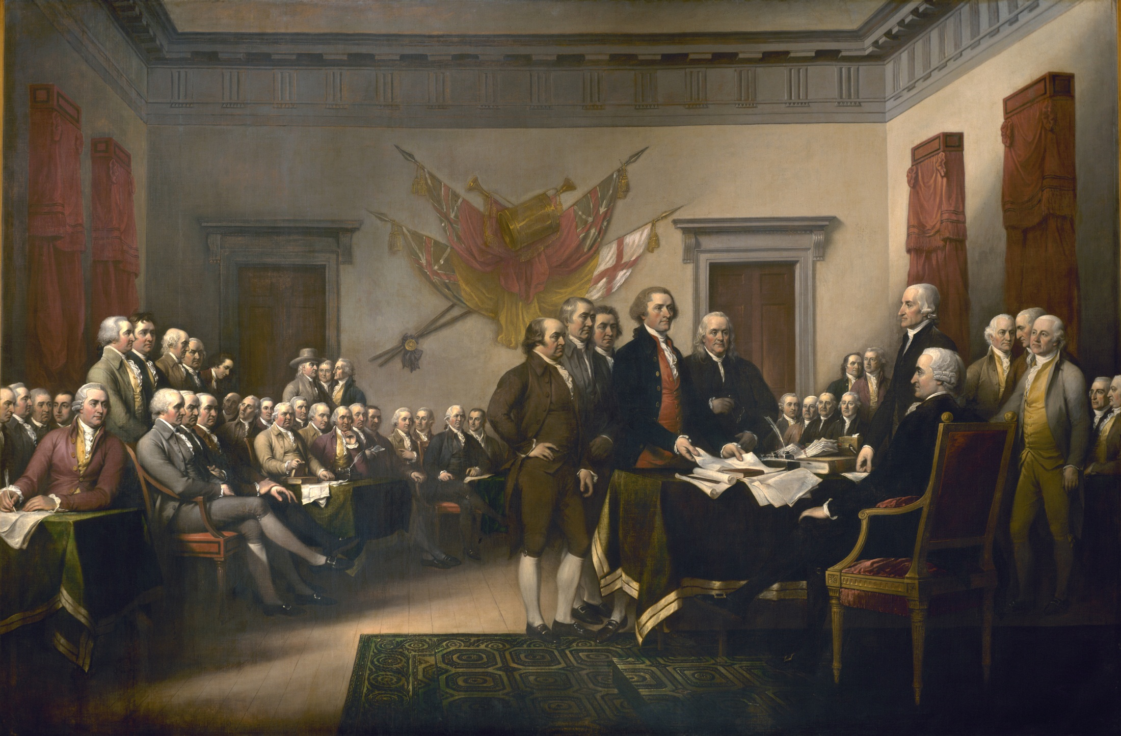
Declaration of Independence, John Trumbull, 1819. The original hangs in the U.S. Capitol in Washington, DC.

Slide 5
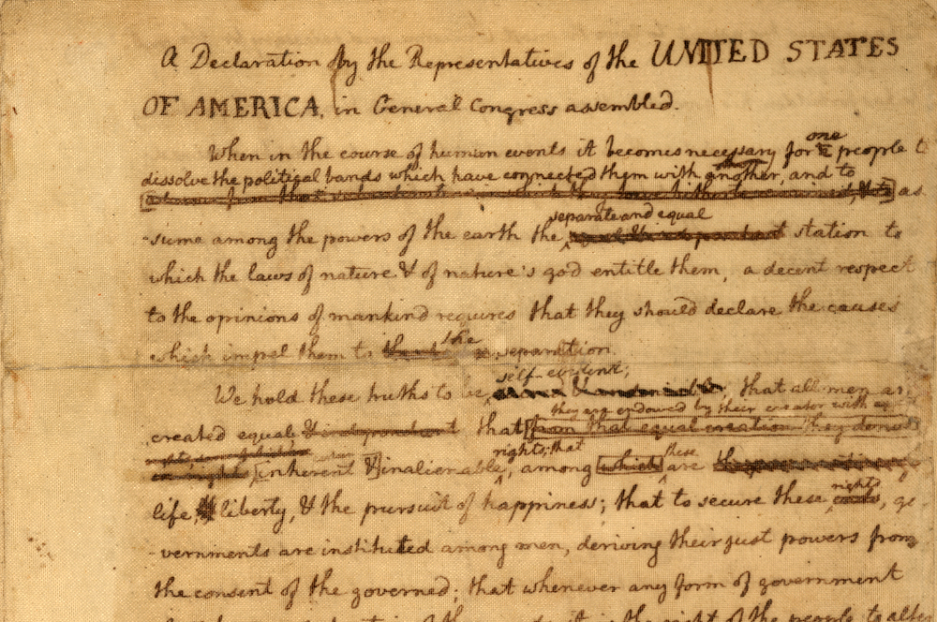

Slide 6
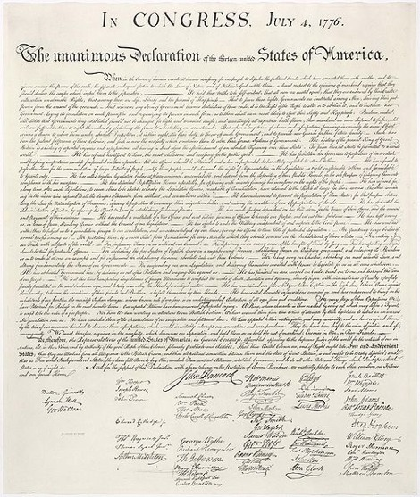

Slide 7
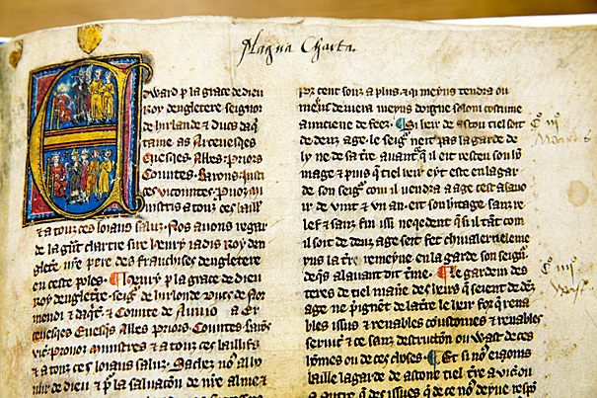
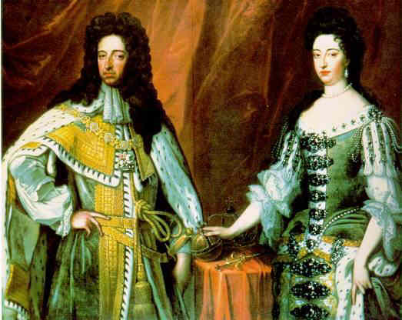
English Influences on the Declaration
The Magna Carta (1215)
The English constitution stating that everybody, including the king or queen, was subject to the rule of law.
The English Bill of Rights (1689)
Limited the power of kings and queens and strengthened freedom of speech.

Slide 8
Enlightenment Influences on the Declaration
Enlightenment ideas – especially those of John Locke – had a major influence on revolutionary leaders.
The social contract theory of government: people owe loyalty only to a government that acts in their best interests.
Natural rights: rights that belong to people simply because they are human, and cannot be taken away. These rights include: “Life, Liberty, and the pursuit of Happiness.”

Slide 9
Enlightenment Influences on the Declaration
The idea that the main reason for government is to protect the natural rights of citizens. If a government fails to live up to this responsibility, then the people have the right to change that government and create a new one.
The idea that the government gets its power from “the consent of the governed.” In other words, people are the source of power in government.

Slide 10
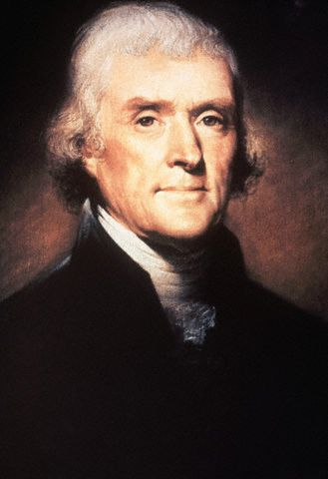
Declaration of Independence
Drafted by Thomas Jefferson
People had the right to “alter or abolish unjust governments.”
Popular sovereignty
All government power comes from the people
Listed grievances, or complaints about all the ways the King had trampled the peoples’ natural rights.
Colonists now had the right to rebel

Slide 11
Directions: Annotate by underlining the key words and phrases in each section, and then translate these to notes using your note taking symbols. Finally, convert your notes to a complete sentence, which will serve as your summary.
 | Section 1 When, in the course of human events, it becomes necessary for one people to dissolve the political bands which have connected them with another, and to assume among the powers of the earth, the separate and equal station to which the laws of nature and of nature's God entitle them, a decent respect to the opinions of mankind requires that they should declare the causes which impel them to the separation.
Section 1 notes: When necessary / dissolve political bands → declare causes /separation
Summary:
When it’s necessary to break political ties, one should explain why.

