Slide 1
Focus Question: What did the American colonies have in common with one another?
Do Now:
Complete Colonial Geography Map analysis activity.

Slide 2
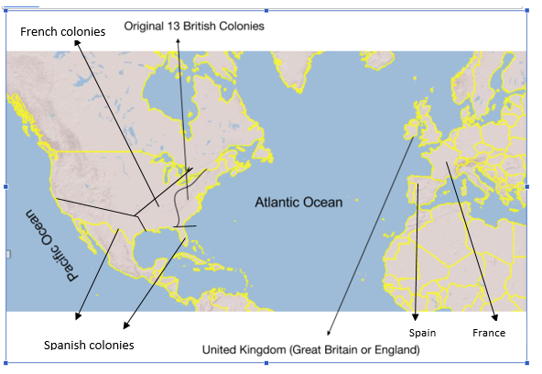
Location of the colonies relative to Europe
1. Notice where England, Spain and France are located on this map. Why do you think the 13 British colonies of North America were settled on the east coast of the continent, and the French and Spanish colonies along the Gulf of Mexico and in the Caribbean Islands?
2. Identify the bodies of water all the colonies (British, French and Spanish) were closest to. Why might access to these waterways be important to the economy and sustainability [ability to last for a long period of time] of the colonies?

Slide 3
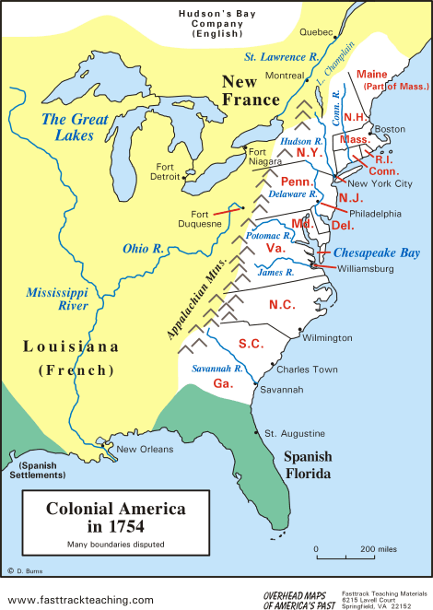
3. What is the name of the mountain range that lines the western edge of the 13 British colonies? Why might the population have first settled east of this mountain range
4. What might have been the effect of having this mountain range between the British and French colonies?

Slide 4
Directions: Convert the following notes into sentences
Note-Taking Symbols
= is / was/ means that / represents + and → led to, leads to, resulted in, results in / comma or period / new idea / missing words
1. England’s rulers thought New World = source/raw materials
England’s rulers thought the New World was a source of raw materials.

Slide 5
Similarities among British colonies
Geography
E. coast Atlantic Ocean / harbors
E. of Appalachian Mts / navigable rivers
Economics
trade w. Britain
mercantilism = trade policies Britain’s econ. benefit
Politics
Salutary Neglect
self-govt

Slide 6
Predictions:
What could have happened between Britain and her colonies by 1763 to spoil this arrangement of Salutary Neglect?
What effect might all those years of colonial self-government have on the relationship between the colonies and England?

