Slide 1
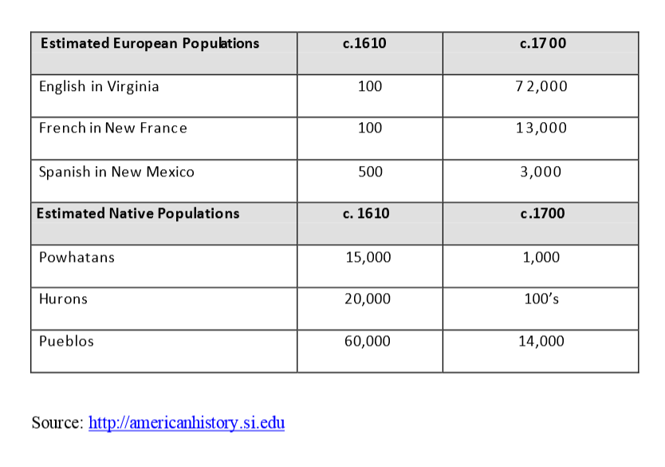
Focus Question: What caused King Phillip’s War of 1675?
Do Now: Describe the change in population from 1610 to 1700 in North America based on this chart.
(Virginia)
(New France)
(New Spain )

Slide 2
(Virginia)
(New France)
(New Spain )
Describe the change in population from 1610 to 1700 based on the chart above by completing the sentences below.
From 1610 – 1700 in North America,…..
……………………………………………………………………
For example,…
…………………………………………………………………………………….

Slide 3
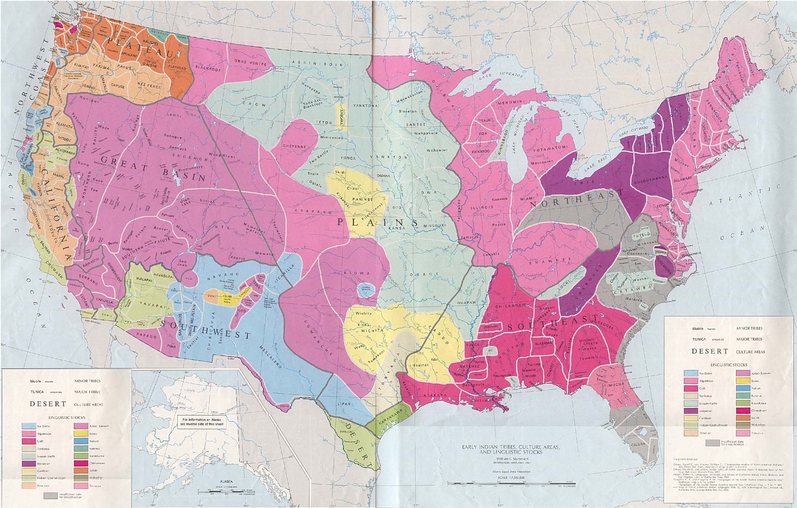
Indigenous Nations at the time of European Settlement

Slide 4
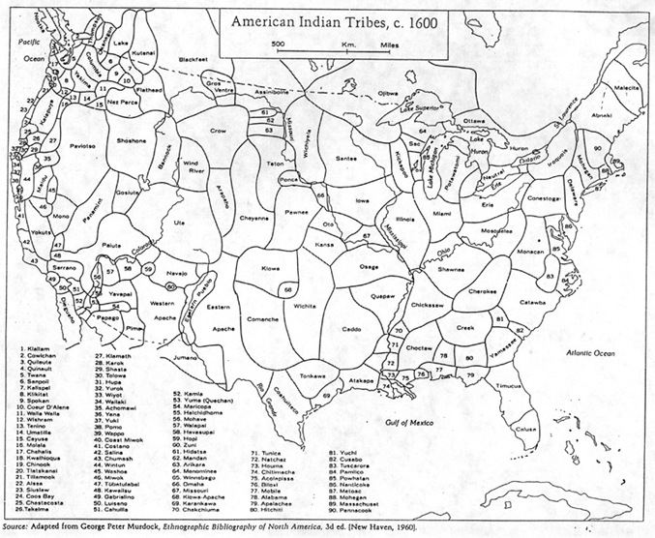

Slide 5
Establishing context: King Philip’s War
Historical Background | So What? / Why might this be important?
New England was relatively peaceful for 40 years after the last Indian war in 1636-37. But during this time Native populations declined rapidly and lost their land and culture.
New England Puritans = very religious Protestant Christians Puritans tried/convert Native Americans + expected/adopt/white customs
Metacomet = Native chief/English called him King Philip 1675/Metacomet/united other Native nations/military alliance + attacked Massachusetts town → war/Europeans named King Philip’s War
Over a year’s time, Europeans and Natives raided one another’s villages and killed hundreds of people; this war was called King Philip’s War.
Relative to the size of the population, King Philip’s War was the most destructive in American history. Five percent of New England’s European population was killed.
Casualties/ war deaths = much higher/local Native American population 40% Native Americans/New England=killed or fled + their power = broken Remaining Native Americans lived/small + scattered communities + served as colonists’ servants + slaves + tenants

Slide 6
Document A: King Philip’s Perspective, as told to John Easton (Modified)
King Philip came unarmed, and about 40 of his men armed. We sat very friendly together. We told him our business. They said that they had done no wrong; the English wronged them. We said that both sides thought the other side wronged them, but our desire was to avoid war. The Indians agreed that fighting was the worst way; then they asked how we might avoid war. We said, by negotiation. They said that they lost many square miles of land through negotiation.
The Indians said they had been the first in doing good to the English, and the English were the first in doing wrong. They said when the English first came, their King’s Father prevented other Indians from wronging the English, and gave the English corn and showed them how to plant, and let the English have a 100 times more land than now the Indian King had for his own people.
And another grievance was, if 20 of their honest Indians testified that a Englishman had done them wrong, it was as nothing; and if but one of their worst Indians testified against any Indian, when it pleased the English it was sufficient.
Another grievance was, the English made them drunk and then cheated them; that now, they had no hope left to keep any land.
Another grievance, the English cattle and horses still increased and kept spoiling their corn. They thought when the English bought land of them they would have kept their cattle upon their own land, but the English didn’t use a fence.
Vocabulary
Grievance: complaint
Sufficient: enough
Source: John Easton, an official from Rhode Island, met King Philip in June of 1675 in an effort to negotiate a settlement. Easton recorded Philip’s complaints. However, Easton was unable to prevent a war, and the fighting broke out the following month.

Slide 7
Document B: Colonists’ Perspective (Modified)
In New England, there are many different theories for what caused the present Indian war. Some blame the people of Boston for trying to Christianize the Indians and for forcing the Indians to observe their laws. They think the Indians are too rude and uncivilized.
Some believe there have been Catholic priests, who have made it their business, for some years past, to turn the Indians against the English and to promise weapons from France.
Others blame the Indian leader, King Philip. Some English tried to get his land and brought him to court and sometimes imprisoned him.
The Puritan government of the Massachusetts believes that God is punishing them for their behavior. Recently, men have been wearing long hair and wigs made of women’s hair; and women have been cutting, curling and laying out the hair. People have not been going to town meetings. The Puritans think that God has allowed the Indians to rise against them.
The English have contributed much to their misfortunes, for they first taught the Indians the use of guns, and let them attend trainings, and showed them how to handle their guns.
The loss to the English in the several colonies, in their habitations and stock, is reckoned to amount to 150,000 pounds. About 1200 houses have been burned, 8000 head of cattle, great and small, killed, and many thousand bushels of wheat and other grain burned, and over 3000 Indians, men, women, and children destroyed.
Source: The English government sent Edward Randolph to New England to report on the causes for the wars with the Native Americans. He wrote this report in 1685.

Slide 8
Corroboration (bring the pieces of evidence together)
What did the different accounts say about what caused King Phillip’s War?
Doc A - King Phillip (as told to Easton) | Doc B - Randolph (colonists’ perspective)

Slide 9
Then write your topic sentence. You can use the sentence starter below, or create your own.
King Phillip’s War, a war between English settlers and Native peoples in 1675, started because………….
……………………………………………………………………………………………………………………………
Now, outline the evidence you will use to make your argument:
Reason 1 ……………………………………………………….… Evidence (from text or context) …………………………………………… Reason 2 ………………………………………………………… Evidence (from text or context) …………………………………………… Reason 3 ………………………………………………………… Evidence (from text or context) ……………………………………………

