Slide 1
Focus Question: How did the British colonies in North America differ from one another? What role did slavery play in the colonial economic system?
Do Now:
Imagine you are a colonial farmer who wants to get rich by selling the crops you grow. In which of these places would you want your farm? A) New England where soil is rocky, summers are short and crops can grow only 3-4 months out of the year, or B) the southern colonies where soil is rich, winters are short and you can grow crops most if not all of the year.
Using this as an example, how can geography (which includes climate) impact or influence a place’s economy?

Slide 3
British American Colonial Regions
 | Impact of GEOGRAPHY on the Region | Main ECONOMIC Activities
New England Colonies Massachusetts Rhode Island New Hampshire Connecticut | New England Colonies’ geography consisted of rocky soil and a short growing season which led to difficulty in growing and exporting cash crops. ………………………………………………………………………. ………………………………………………………………………. ………………………………………………………………………. | The ports were important because they provided opportunities for fishing, whaling and ship building. Fish, whale oil, sugar, fur and leather goods were all traded with Europe. ………………………………………………………………………. ………………………………………………………………………. ……………………………………………………………………….
Middle Colonies New York New Jersey Pennsylvania Delaware | The longer growing seasons coupled with the less rocky soil and mild winters led to farmers cultivating a variety of grains. ………………………………………………………………………. ………………………………………………………………………. ………………………………………………………………………. | The Middle Colonies were called “breadbasket colonies” because they grew the highest percentage of grain in major manufacturing centers which were New York City and Philadelphia. ………………………………………………………………………. ………………………………………………………………………. ……………………………………………………………………….

Slide 4
British American Colonial Regions
 | Impact of GEOGRAPHY on the Region | Main ECONOMIC Activities
Southern Colonies Virginia Maryland North Carolina South Carolina Georgia | The rich soil, warm winters and humid summer led to crops being grown all year and allowed for the farming of tobacco and rice. ………………………………………………………………………. ………………………………………………………………………. ………………………………………………………………………. | Tobacco and rice were the most profitable crops of the 13 colonies. About 90% of Southern exports were agricultural and were harvested by slave labor on plantations. ………………………………………………………………………. ………………………………………………………………………. ……………………………………………………………………….

Slide 5
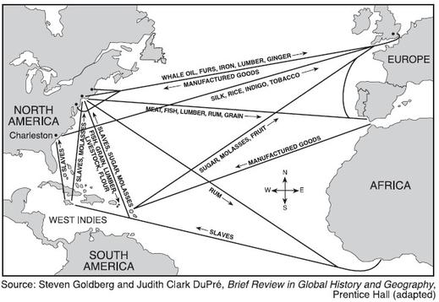

Slide 6
What is Mercantilism?
An economic system in Europe from the 16th to the 18th centuries designed to make these countries rich! It had 3 main components:
Sponsor colonies in faraway lands loyal to the mother country
Export resources from those colonies to the mother country at cheap prices
Sell goods produced in the mother country to people settled in the colonies

Slide 7
In other words…
mercantilism is economic system where a powerful country imports raw materials from its colonies and sells products there, in order to increase its wealth.

Slide 8
