Slide 1
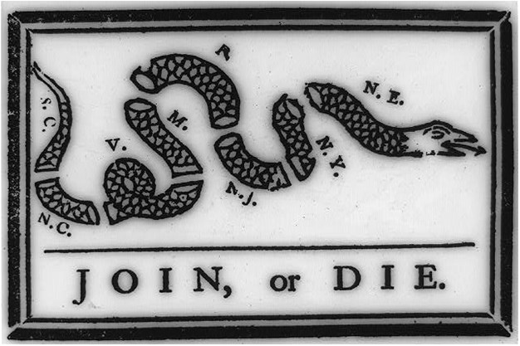
Focus Question: What put the American colonists on the road to revolution against England?
Do Now:
Analyze this early political cartoon by answering the guided questions in your handbook.

Slide 2
Salutary Neglect
Describes how England treated the American colonies for 150 years (since the founding of their American colonies).
Definition:
When England overlooked some rule breaking as long as they were making money from the colonies. They neglected the colonies, but in a good (salutary or healthy) way.

Slide 3
Note-Taking Symbols
= is / was/ means that / represents ≠ is not/ was not/ does not mean + and → led to, leads to, resulted in, results in / comma or period / new idea / missing words
The American Revolution was not inevitable. In history, events are not inevitable. People that live through events never see the event as inevitable. Distinct economies and ways of life led to differences among the British colonies in North America. A lack of modern communication and travel methods led to difficulty communicating effectively and supporting a common political agenda.
The American Revolution was not inevitable. In history, events are not inevitable. Distinct economies and ways of life led to differences among the British colonies in North America. A lack of modern communication and travel methods led to difficulty communicating effectively and difficulty supporting a common political agenda.
Notes:
American Revolution ≠ inevitable
events ≠ inevitable
distinct economies + ways/life → differences/British colonies/North America
lack/modern communication + travel methods → difficulty communicating + difficulty supporting/common political agenda

Slide 4
The American Revolution was not inevitable!
At the end of the Seven Year’s War, most colonists were happy being part of the British Empire. Being part of the British Empire led to commercial prosperity and military security. White colonists had many of the same political rights of English people. Some examples of the political rights of white colonists were free speech and press. Additionally, colonies were largely self-governed. Living in the colonies led to white men having a better chance at earning a good living than they would have had in Europe.
end/Seven Year’s War/most colonists = happy/part/British Empire
being part/British Empire → commercial prosperity + military security
white colonists/many/same political rights/English people
examples/political rights/white colonists = free speech + press
colonies = self-governed
living/colonies → white men/better chance/earning/good living/than/in Europe

Slide 5
Annotate Article
A = what made colonists angry
R= examples of colonists resisting British laws
PE = Peace Efforts/Attempts at Compromise
V = Examples of conflict escalating to violence.

Slide 6
Exit Ticket / Homework
Although British tax laws of the 1760s may seem inconsequential to us, to American colonists__________
______________________________________________
_______________________________________________.

