Slide 1
Focus Question: What choices faced people living in the British colonies around 1776?
Do Now:
What are some reasons why a colonist would remain loyal to the King of England?

Slide 2
By 1776, colonists were extremely divided over what to do about the crisis in their relationship with Britain. About 40% were Patriots, colonists that supported independence. 20% were Loyalists, colonists who wanted to remain part of Britain. 40% of colonists were unsure of their position. The percentages of each camp varied from colony to colony. The New York colony was home to the highest percentage of Loyalists.

Slide 3
The debate raged. Pamphlets, cheaply produced little books, were the media of the day. Because some colonists were not literate, pamphlets were read aloud in pubs, on the street and wherever people gathered. Everyone debated the issues of the day.

Slide 4
Thomas Paine’s “Common Sense,” a pamphlet which put forth the arguments for independence, was the most popular. “Common Sense” was the first American best seller. It was published in January 1776 and sold as many as 500,000 in the first year. “Common Sense” convinced many people to support independence, but many remained Loyalists throughout the war.

Slide 5
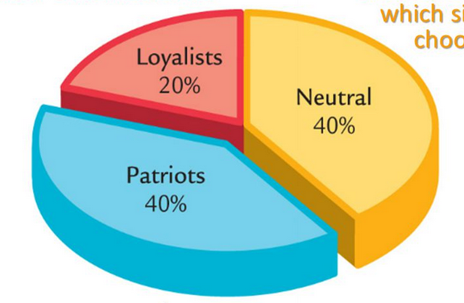
Colonists were very divided in their opinion of the British around 1776
Loyalists were in favor of remaining part of Britain
Those who were neutral were undecided.
Those who supported independence called themselves Patriots

Slide 6
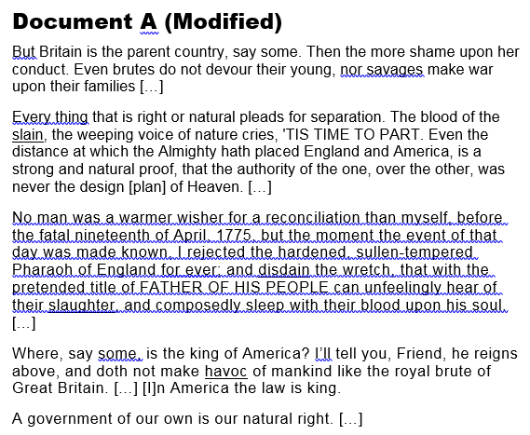

Slide 7
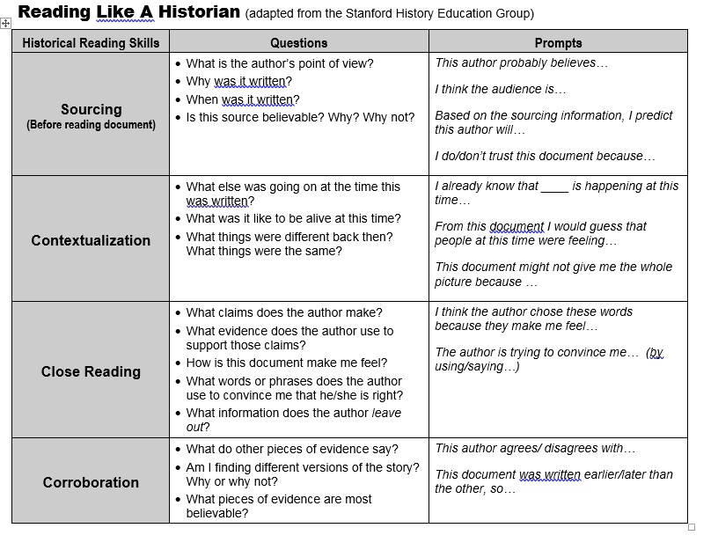

Slide 8
Sourcing (Predict meaning based on source information):
Document A
Notes:
Jan 1776
To Americans
Anonymous
Prediction (full sentence):
I would predict that someone publishing a pamphlet anonymously in early 1776 probably advocated independence.
Document B
Notes:
Prediction (full sentence):

Slide 9
Contextualization (consider what else was going on at the time based on what you know about the time and clues in the text):
General context (what you know about the time these were written):
Colonists = divided!
Relationship w Brits = in crisis
Battles in 1775
Olive Branch = tried for compromise
Big debates

Slide 10
Close Reading
(What claims is the author making?
How does s/he make them?)
Document A
Claim 1
Britain = Tyrant
Evidence:
Brits killed Ams in battles 1775
Parents kill their kids
Claim 2:
Democ. Govt = Natural Right
Evidence:
In Am / Law = King
Tyranny “plan of heaven”
Document B
Claim 1
Evidence:
Claim 2:
Evidence:

Slide 12
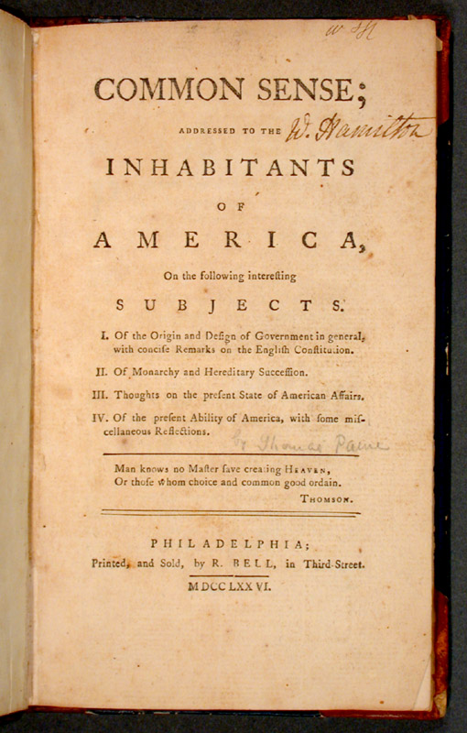
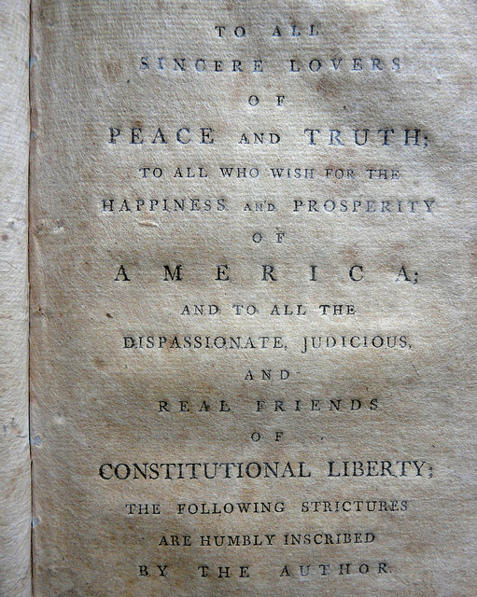
Pamphlets were an inexpensive way to get the word out –the mass media of the colonial era.
Original cover of Common Sense Pamphlet by Thomas Paine Public domain http://www.indiana.edu/~liblilly/history/common-sense-larger.html
Pamphlet by Charles Inglis responding to Common Sense. No known copyright restrictions https://www.flickr.com/photos/nlscotland/7942601040/in/photostream/

Slide 13
Exit Ticket /HW Complete the following two sentences
In 1776, some colonists remained loyal to the British because…………………………………………………
………………………………………………………………………
In 1776, some colonists remained loyal to the British, but…………………..………………………………………………………………………………………

