Slide 1
Focus Question: Did Jefferson’s Louisiana Purchase create an “empire for liberty” as he hoped it would?
Do Now:
In your handout, Read the context introduction and quotation, then
On the map, label New Orleans and the Mississippi River.
Answer the Regents multiple choice question

Slide 2
Mississippi
River
New Orleans

Slide 3
CONTEXT:
When Thomas Jefferson was elected President in 1800, Spain owned the city of New Orleans, which sits at the mouth of the Mississippi River. Spain had allowed Americans to ship goods down the Mississippi through the port of New Orleans. Then, in 1802, Spain decided to trade the whole Louisiana Territory to France, which was ruled then by Napoleon.
…There is on the globe one single spot, the possessor of which is our natural and habitual enemy. It is New Orleans, through which the produce of three-eighths of our territory must pass to market, and from its fertility it will before long yield more than half of our whole produce and contain more than half our inhabitants. France, placing herself in that door, assumes to us the attitude of defiance….
-Letter from President Thomas Jefferson to Robert Livingston, April 18th, 1802

Slide 4
Predict in prep for a video: Make a prediction about the video we are going to watch based on its title: “The historical audacity of the Louisiana Purchase.” Audacity means bold, brave, gutsy. (An audacious person is someone who is bold or daring.)
https://ed.ted.com/lessons/the-audacity-behind-the-louisiana-purchase-judy-walton

Slide 5
In pairs, answer the following questions:
What does the word implied mean? What, then, is meant by the phrase “implied powers’’ of the Constitution?
Why was it ironic that Jefferson took this bold, powerful act?
Write one question you still have about the Louisiana Purchase after seeing the video.

Slide 6
The Louisiana Purchase (1803)
Violated Jefferson’s belief in limited gov’t.
Bought from France for $15 million.
It doubled the size of the U.S.
Gave U.S. control of New Orleans.
U.S. gained control of Mississippi River.
Important for transportation and trade.
Led to Manifest Destiny.
The idea that God wanted the U.S. to take over all the territory in North America from the Atlantic Ocean to the Pacific Ocean.

Slide 7
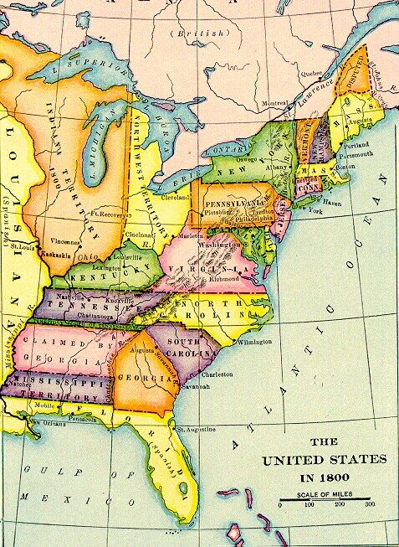

Slide 8
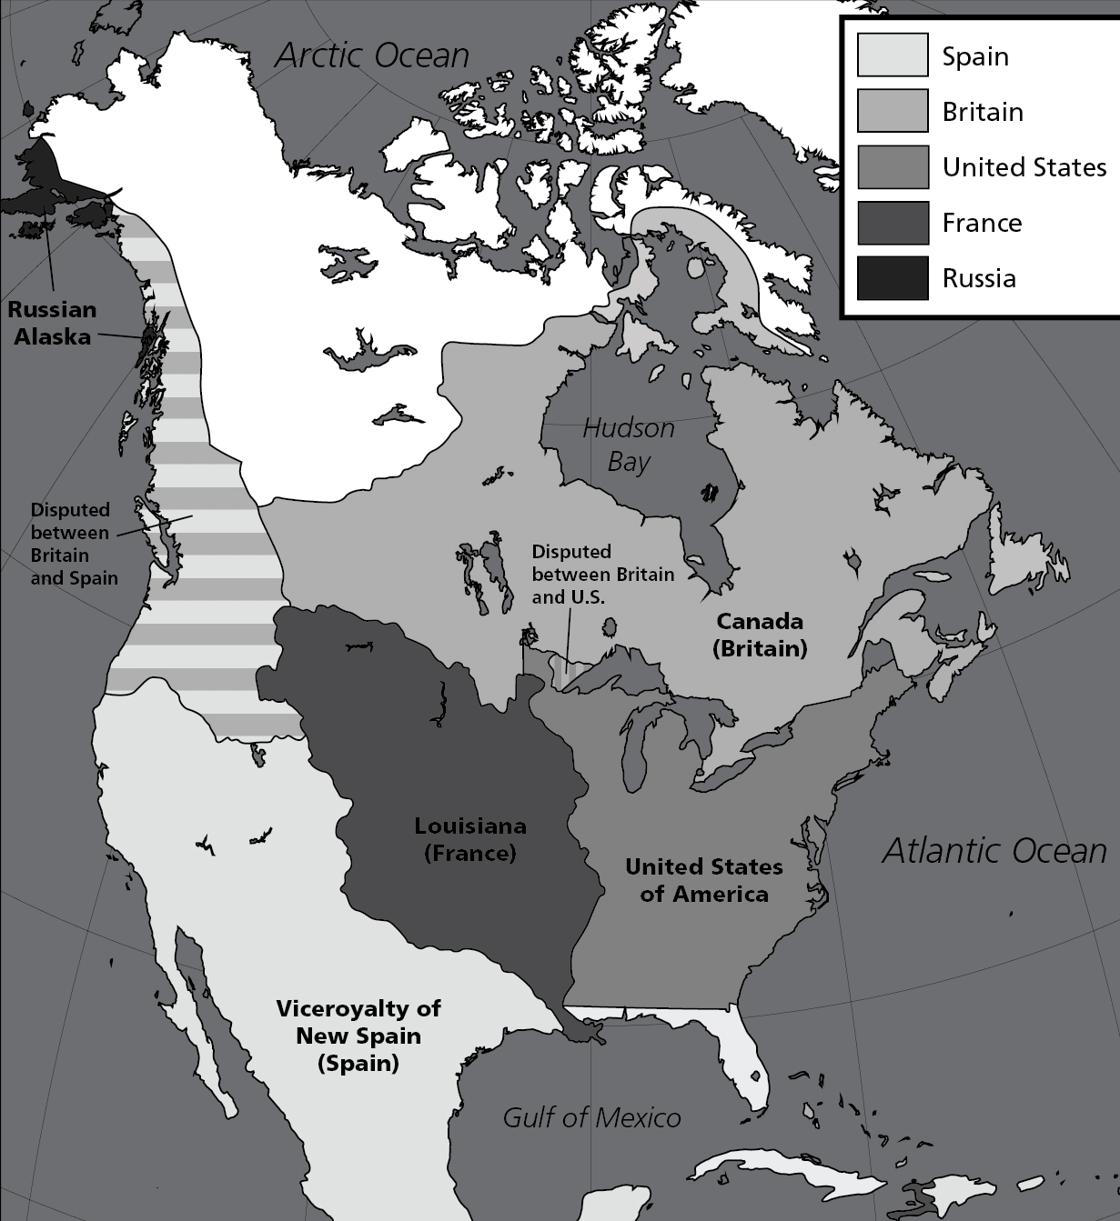

Slide 9
What did Jefferson mean by an “empire of liberty”?
“…and we should have such an empire for liberty as she has never surveyed (measured out) since the creation: & I am persuaded no constitution was ever before so well calculated as ours for extensive empire & self-government."
-Jefferson letter to James Madison, 27 April 1809

Slide 10
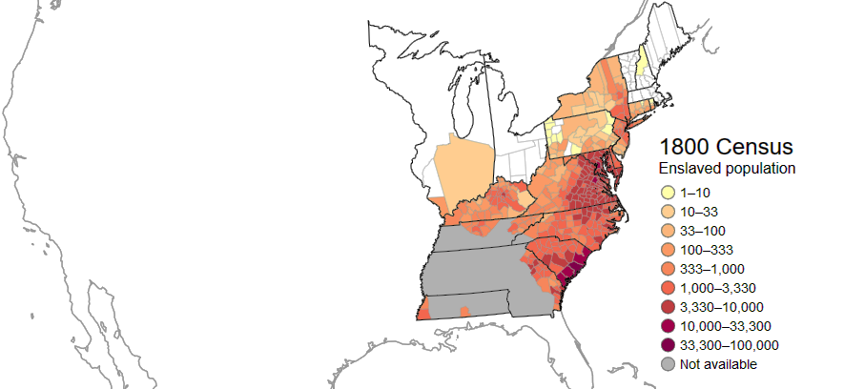
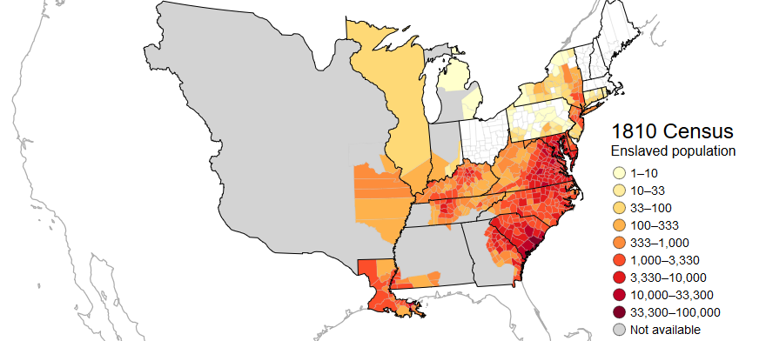

Slide 11
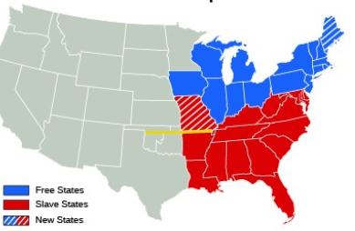
“A Fire Bell in the Night”
In 1818 the balance in Congress = 11 “slave states” (red), 11 free states (blue).
Missouri
Missouri asks to be admitted as a “slave” state in 1818 → CRISIS!
(death knell, or bell rung at death)
Thomas Jefferson on the Missouri Crisis:
“…this momentous question [the Missouri Crisis], like a fire bell in the night, awakened and filled me with terror. I considered it at once as the knell of the Union. -Thomas Jefferson to John Holmes, 22 April 1820

Slide 12
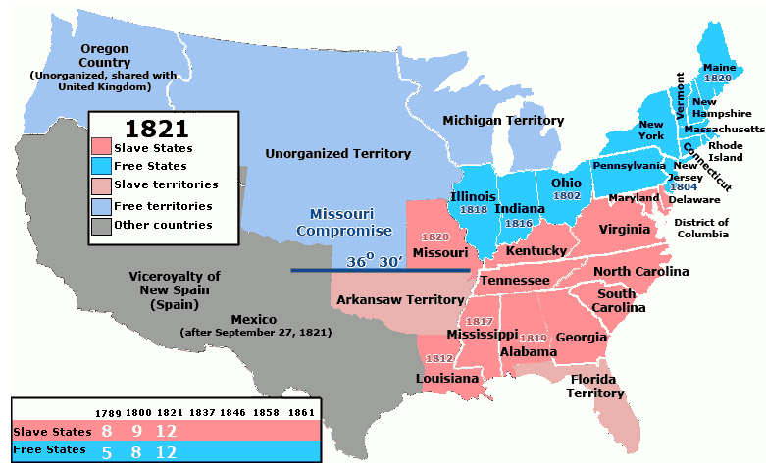
Sectional Crisis or sectionalism = division of the nation into rival sections over slavery.
Congress also created this line, above which slavery was outlawed.
To keep the balance of “slave” and “free” states, Maine was added as “free” and Missouri as “slave” in the Missouri Compromise of 1821.

Slide 13
Exit Ticket/Homework
Directions: Complete each of the following sentences based on your knowledge of the Louisiana Purchase.
Thomas Jefferson believed the U.S. needed more land because_______________
___________________________________________________________________
___________________________________________________________________
Thomas Jefferson believed the U.S. needed more land, but____________________
___________________________________________________________________
___________________________________________________________________
Thomas Jefferson believed the U.S. needed more land, so____________________
___________________________________________________________________
___________________________________________________________________

